Slide 1
Naga Jyothi Sri
Podcast Application

Slide 2
Project About Podcast
Project overview
The problem:
User not easily find the categories like Education,Sports,Music Etc.
User wants to see some newly uploaded videos when he opens a player.
User wants to listen the Podcast while sleeping or working.
The player should stop automatic.
.
The product:
I have developed a Podcast application.
A podcast is an episodic series of digital audio or video files that a user can download to a personal device to listen to at a time of their choosing.
Project duration:
3 Months
The goal:
User want listen the podcast in there daily life.While he is working, Travelling, sleeping etc…
My role:
UX designer

Slide 3
Understanding
the user
User research
Personas
Problem statements
User journey maps

Slide 4
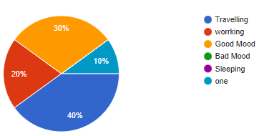
User research: summary
I have researched some podcast apps and websites.
In my research I observed some apps didn't have some of the features are missing and most of the users listing the podcast by travelling

Slide 5
User research: pain points
1
2
3
4
Pain point
Pain point
Pain point
Pain point
It is not easy find the solution because he want to switch off the player and want to sleep.
Not easily find the categories like Education,Sports,News,
Music Etc…
He wants to listen the Podcast while sleeping.
He don't have receive similar recommendation.
He wants to receive some notification of newly uploaded.

Slide 6
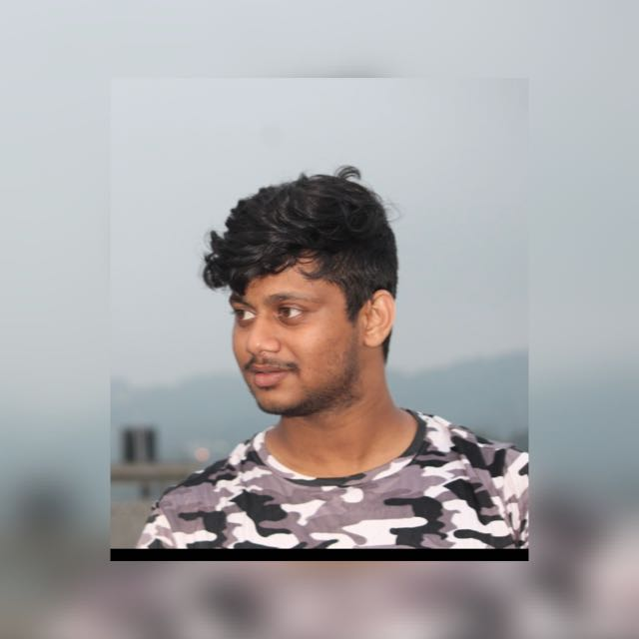
Persona:Shiva (SAP Developer) 30
Characteristics and context:
A bachelor
Lives in India
Loves to listen the Podcast .
Tasks:
Create a own playlist.
Easy access to information from google.
Pain points:
Not easily find the categories like Education,Sports,News,
Music Etc…
He don't have receive similar recommendation.
He wants to receive some notification of newly uploaded
Goals:
Listen the Podcast in her daily life.
He want to choose one category.
He will enjoy.

Slide 7
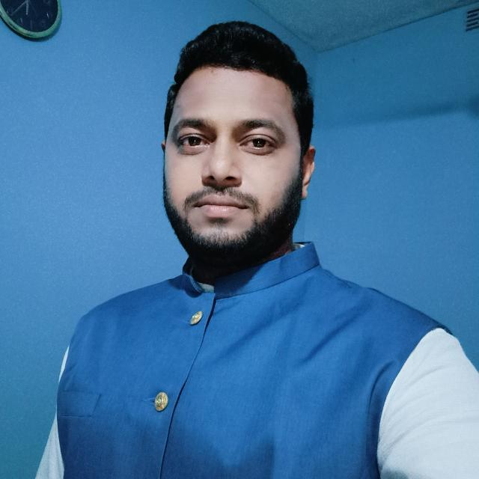
Persona:Kassi (Technisches) 38
Characteristics and context:
He is Married
Lives in India
Loves to listen the Podcast.
Tasks:
Create a list and he want to listen the Podcast will he is working or travelling etc…
Pain points:
Not easily find the categories..
He wants to listen the Podcast while sleeping.
It is not easy find the solution because he want to switch off the player and want to sleep.
Goals:
Listen the podcast in her daily life.
While he is working, Travelling, sleeping etc…

Slide 8
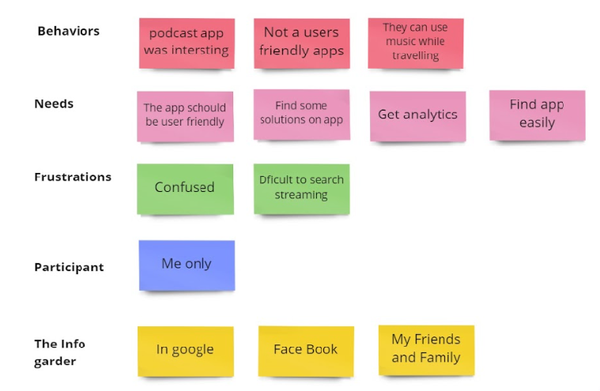
User journey map
With these pain points in mind, my goal was to create a more easy and memorable listening experience for podcast listeners who travels to work daily.

Slide 9
Paper wireframes
Digital wireframes
Low-fidelity prototype
Usability studies
Starting
the design

Slide 10
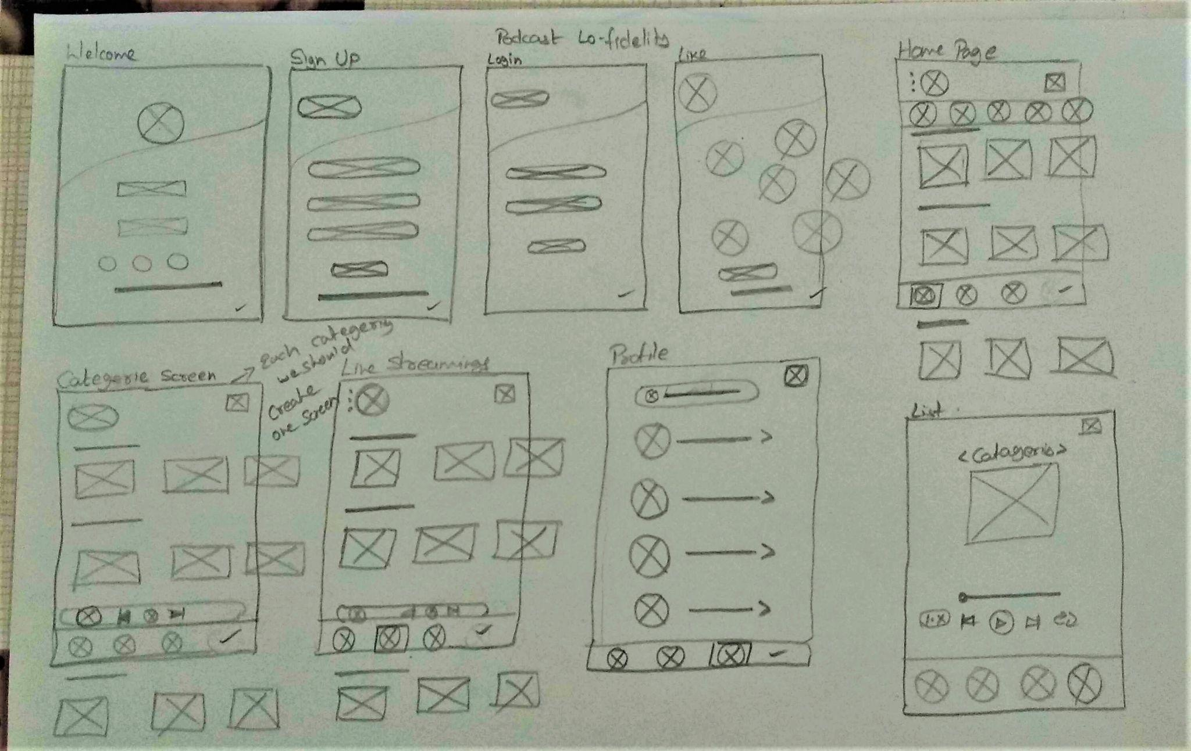
Paper wireframes
My goal is to keep the user should easily understand.

Slide 11
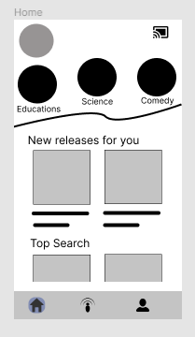
Digital wireframes:
I am trying to show on this screen.The user can search the categories in an easy way.
These elements shows they are the categories of the play list.
This playlist shows all kinds of New releases, Top search, and Playlist on this screen.
This is the home screen. Down highlighted button shows the page.

Slide 12
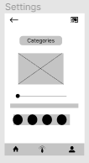
Digital wireframes:
I am trying to show on this screen.The user can create a favorite list and he can fix some timer for this screen. After fixing the time it will automatically turn off. We have no need to stop.
Here we can go back the favorites screen.
In this elements we fix a timer.

Slide 13
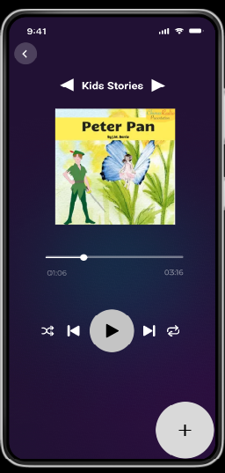
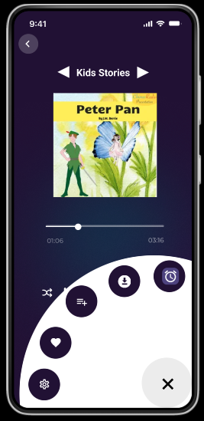
Low-fidelity prototype:
I have developed the screen with some icons. The user can easily understand.

Slide 14
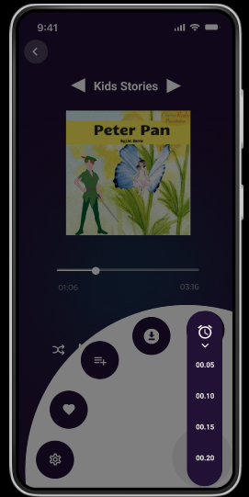
I have developed the screen with Timer icons. The user can easily use this timer while he is working, travelling, Relaxing etc…
The timer will turn off automatically.

Slide 15
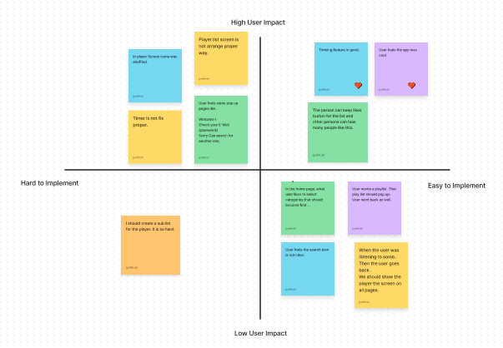
Usability study findings:

Slide 16
Refining
the design
Mockups
High-fidelity prototype

Slide 17
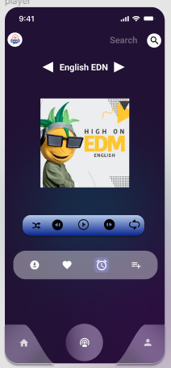
Mockups
Before usability study
After usability study
In first player screen icons was more .It was not clear to understand.
In Second player screen icons was more .It was not clear to understand.

Slide 18
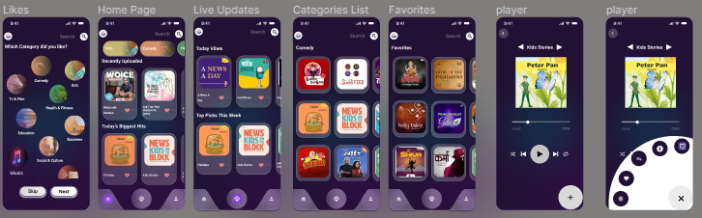
High-fidelity prototype:
Link prototype:
https://www.figma.com/proto/PF4t6QbljcoMNXgzBaOW4E/Podcast?node-id=216%3A616&scaling=scale-down&page-id=0%3A1&starting-point-node-id=216%3A616

Slide 19
What I learned:
In this project, I understand how the user role is very important to the project.
I have understand What is the role of UX Research can do in the real world.
Thank you for giving this opportunities.

